Slide 1
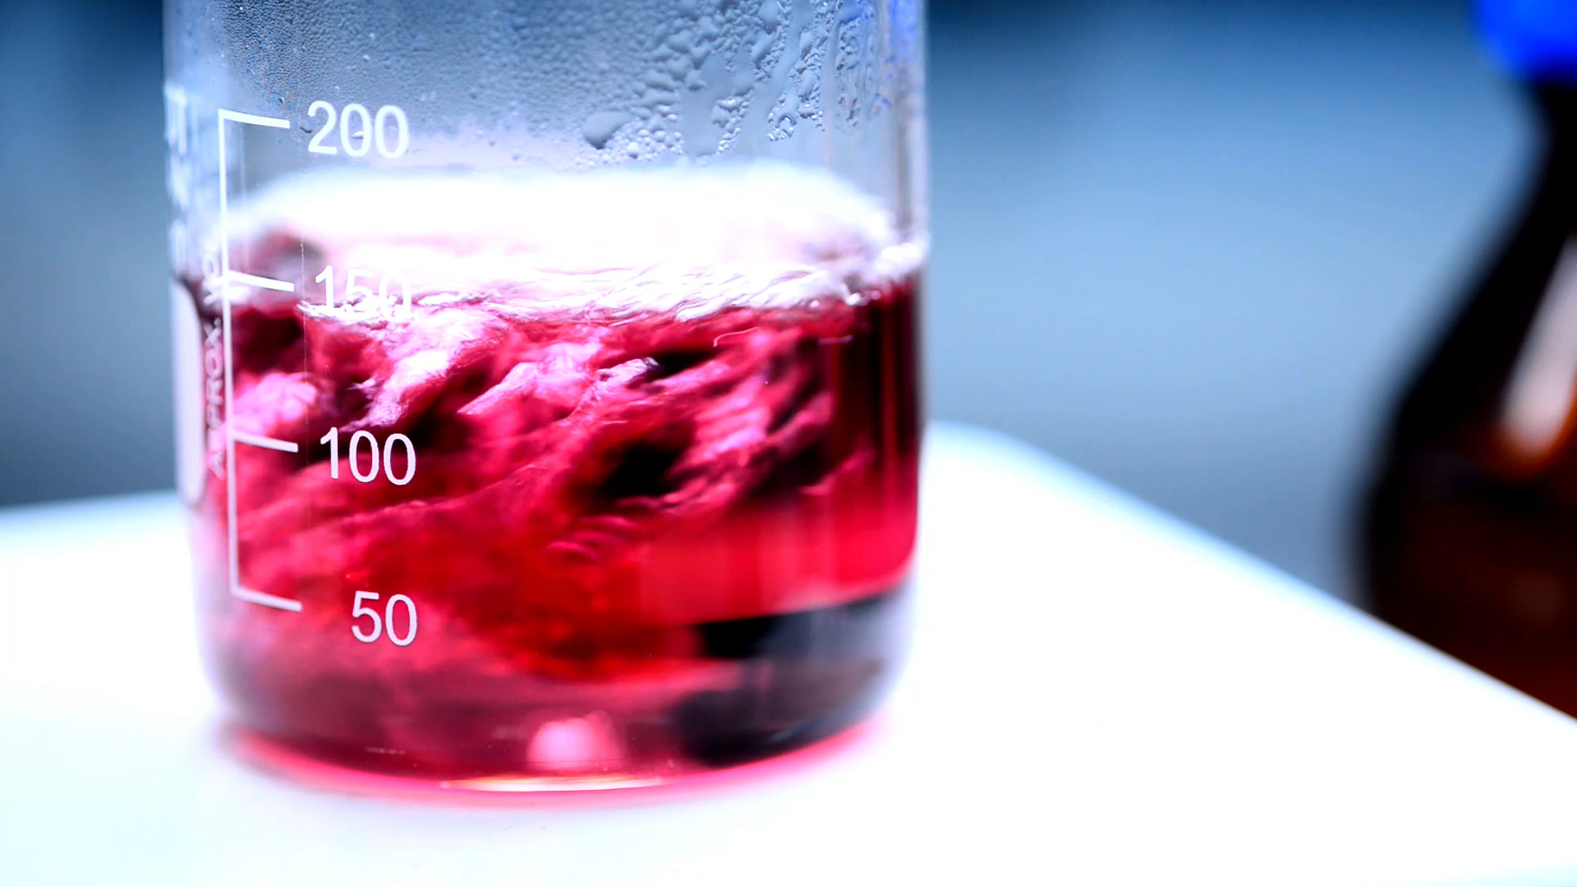
Analysis of variance and experimental design

Slide 2

Table of contents
Introduction of the problem
Analysis of R outcome
P-value
Interaction term and plots
Best selected model
Analysis of the residuals

Slide 3
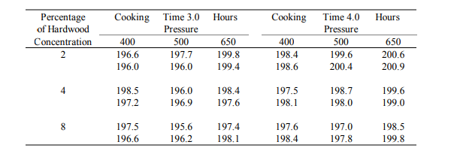
Paper strength
we are looking at effects of hardwood concentration in raw pulp, vat pressure, and pulp cooking duration on paper strength. There are three levels of hardwood concentration (2,4,8), three pressure levels (400,500,650), and two cooking times (3 hours, 4 hours) to choose from. After conducting a 3-factorial way anova design using R studio, we get the following results:

Slide 4
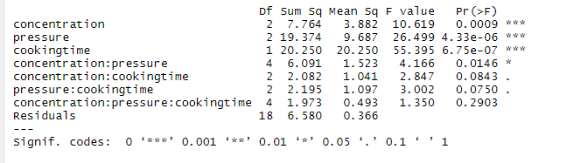
Analysis of R outcome
1- P-value

Slide 5
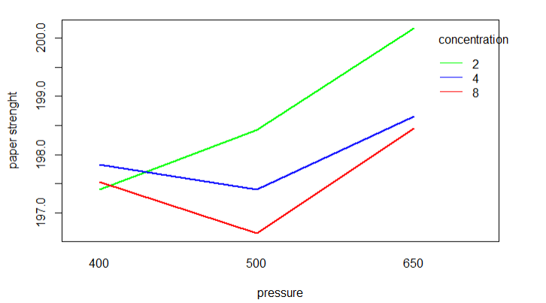
2- Interaction term and plots
There is an Interaction between the concentration and pressure.
Notes:
In general, if the two lines on the interaction plot are parallel then there is no interaction effect. However, if the lines intersect then there is likely an interaction effect.
We can see in this plot that the lines for males and females do intersect, which indicates that there is likely an interaction effect between the variables of exercise intensity and gender.
This matches the fact that the p-value in the output of the ANOVA table was statistically significant for the interaction term in the ANOVA model.

Slide 6
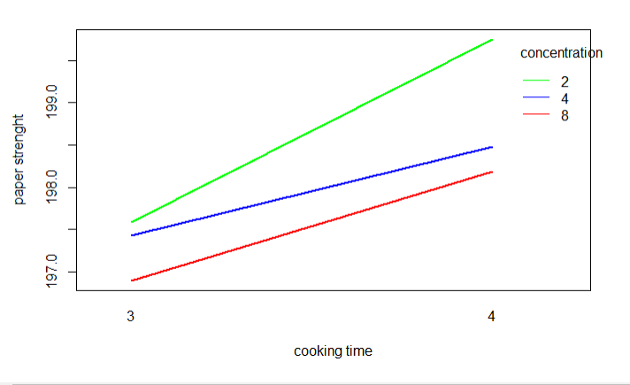
No Interaction between the concentration and cooking time

Slide 7
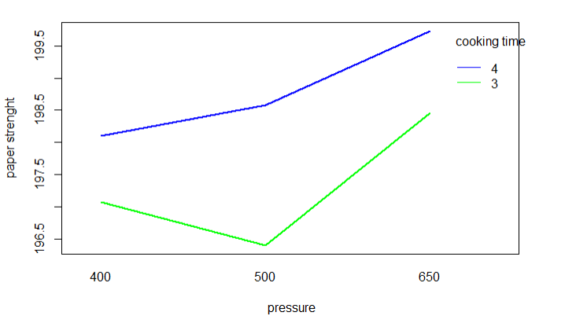
No Interaction between the pressure and cooking time

Slide 8
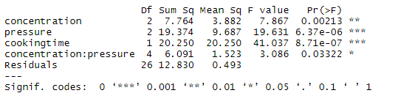
3-Best selected model
Hence, our model will be:
paper strength = concentration + pressure +cooking time + concentration*pressure.
For the highest strength, we run the process with the pressure at 650, concentration of hardwood at 2, and the time at 4 hours.
Notes:
For the highest strength, run the process with the percentage of hardwood at 2, the pressure at 650, and the time at 4 hours.

Slide 9
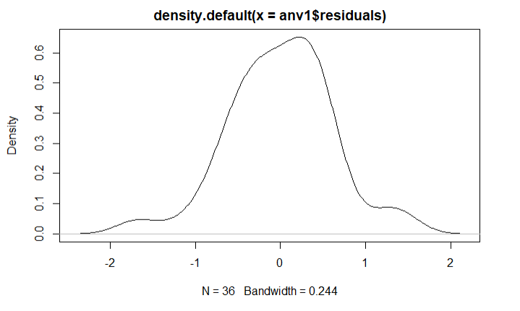
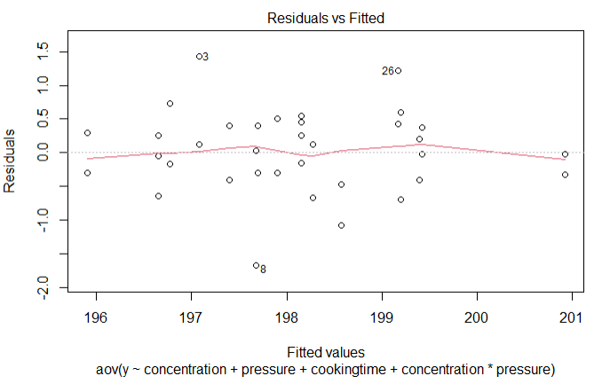
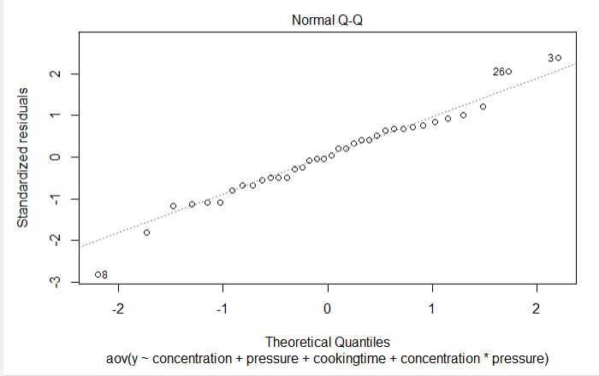
Analysis of the residuals

Slide 10

Thank you

